Slide 1
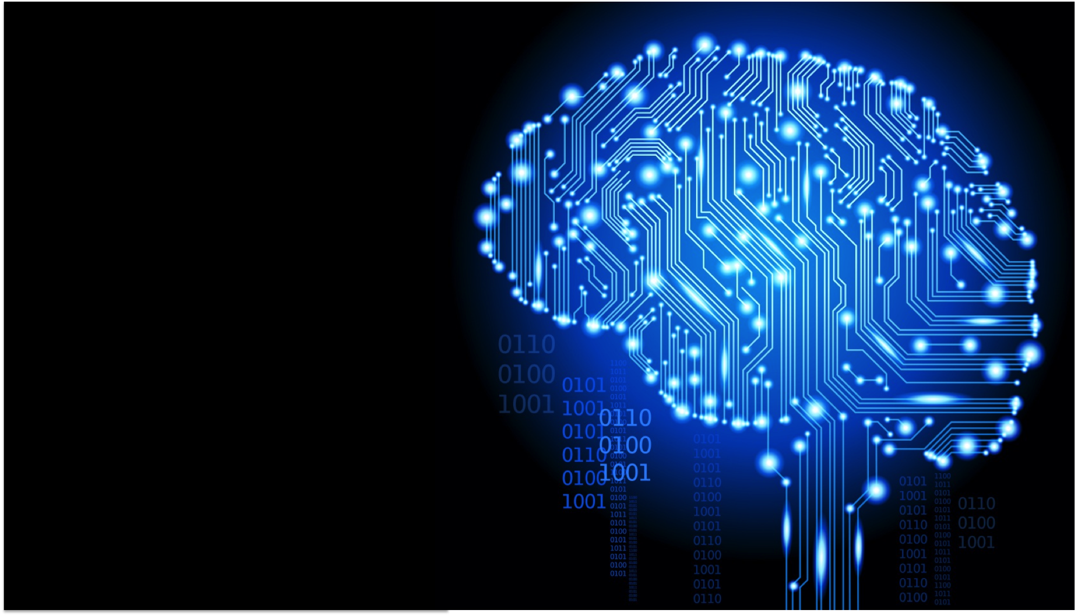
Lecture 1: Introduction to Neural Networks and Deep Learning
Deep Learning @ UvA

Slide 2
Course Logistics
Course: Theory (4 hours per week) + Labs (4 hours per week)
Assignments in Torch
Free to choose your own framework (with some rules)
The times, days and rooms are different each week
Detailed schedule: https://datanose.nl/#course[46217]
Final grade = 50% from lab assignments + 50% from final exam
5 lab assignments = (50 + 100 + 100 + 100 +100)=450 points in total
The assignments should be done individually
+ Bonus questions to recover points
7 free late days in total for all assignments. Use them as you please. After that lose 10% per extra late day

Slide 3
Prerequisites
Calculus, Linear Algebra
Gradients
Matrix operations
Probability and Statistics
Advanced programming
Time and patience

Slide 4
Course overview
Course designed to go in depth in theory and get hands-on practical experience
Organized lectures and practicals in 5 thematic groups
Theme 1: How to learn with a neural network?
Theme 2: How to classify pixels?
Theme 3: How to synthesize words?
Theme 4: Unsupervised and Bayesian Deep Learning
Theme 5: The bigger picture
Slides, lecture notes and papers
All posted on the course website
Book on Neural Networks and Deep Learning from Y. Bengio

Slide 5
Lecture Overview
Deep Learning in
Computer Vision
Natural Language Processing (NLP)
Speech
Robotics and AI
Music and the arts!
A brief history of Neural Networks and Deep Learning
Basics of Neural Networks

Slide 6
Who we are and how to reach us
Taught by Efstratios Gavves, Max Welling, Patrick Putzky (Teaching Assistant)
Course website
http://uvadlc.github.io
Lectures, lecture notes, practicals, extra info regarding the course content
Classroom website
www.piazza.com/university_of_amsterdam/spring2016/uvadlc/home
Participate in a virtual classroom, ask questions to us and your fellow students, get in contact with others, check grades etc.
Email us at
uva.deeplearning@gmail.com

Slide 7
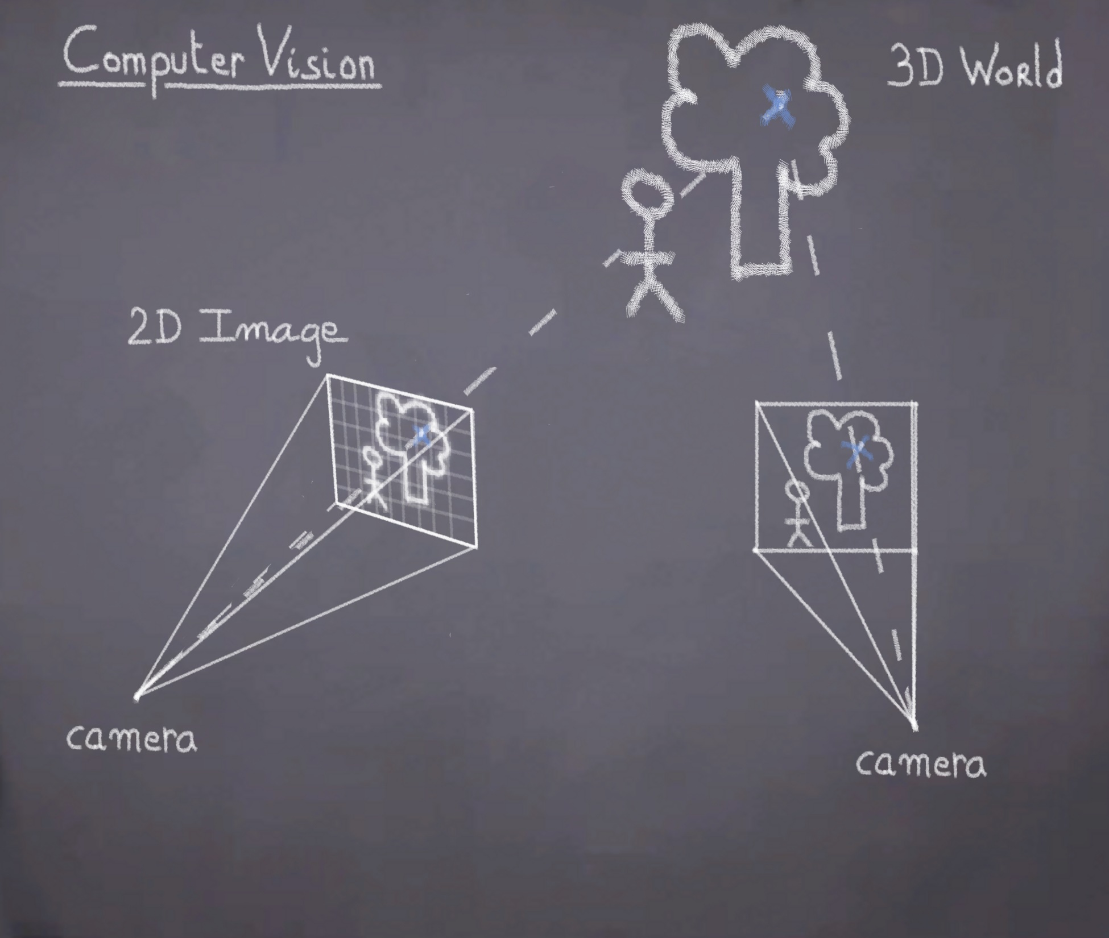
Deep Learning in Computer Vision

Slide 8
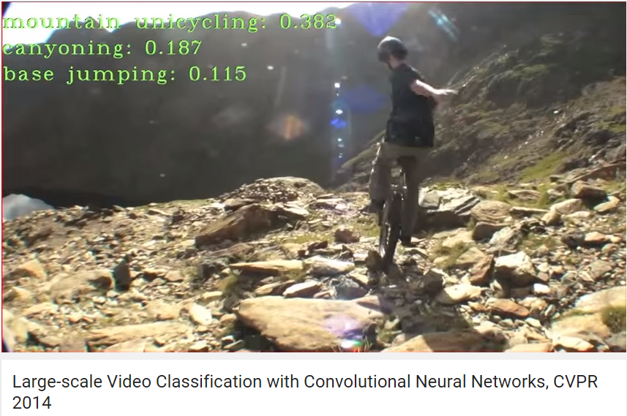
Object and activity recognition
Click to go to the video in Youtube

Slide 9
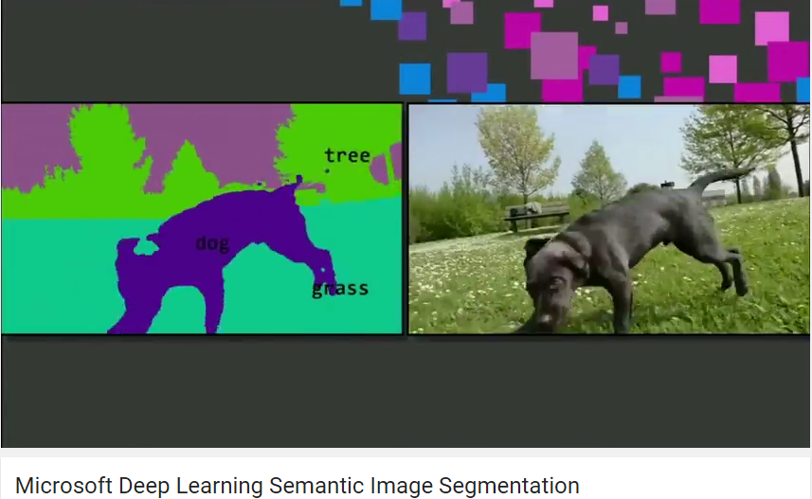
Object detection and segmentation
Click to go to the video in Youtube

Slide 10
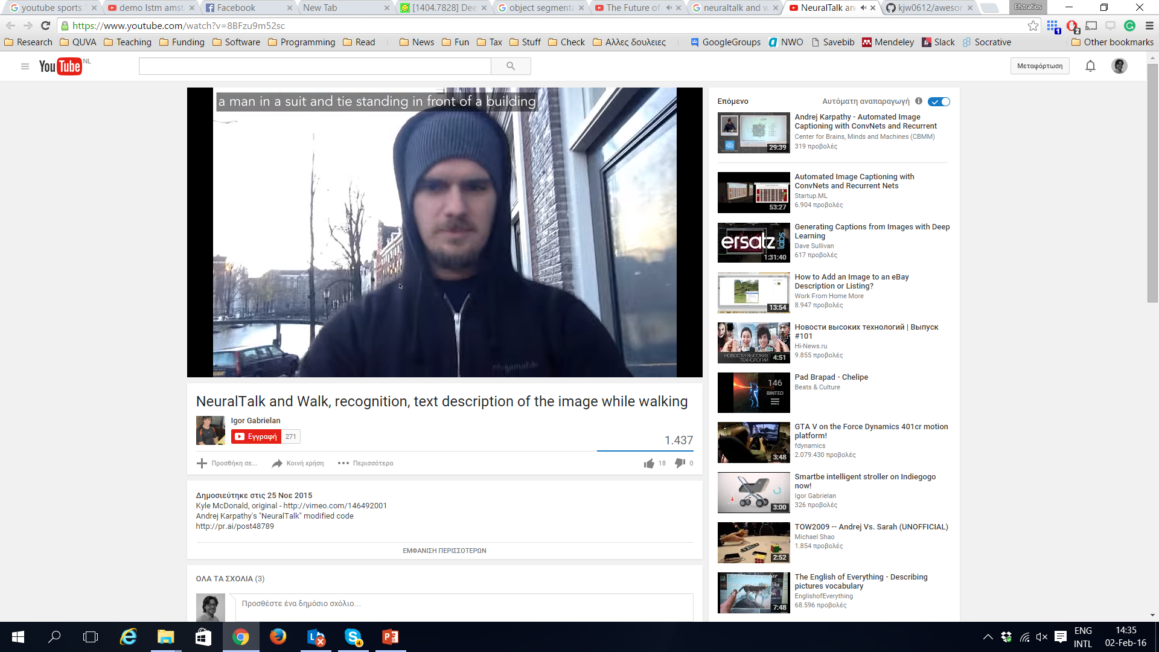

Image captioning and Q&A
Click to go to the video in Youtube
Click to go to the website

Slide 11
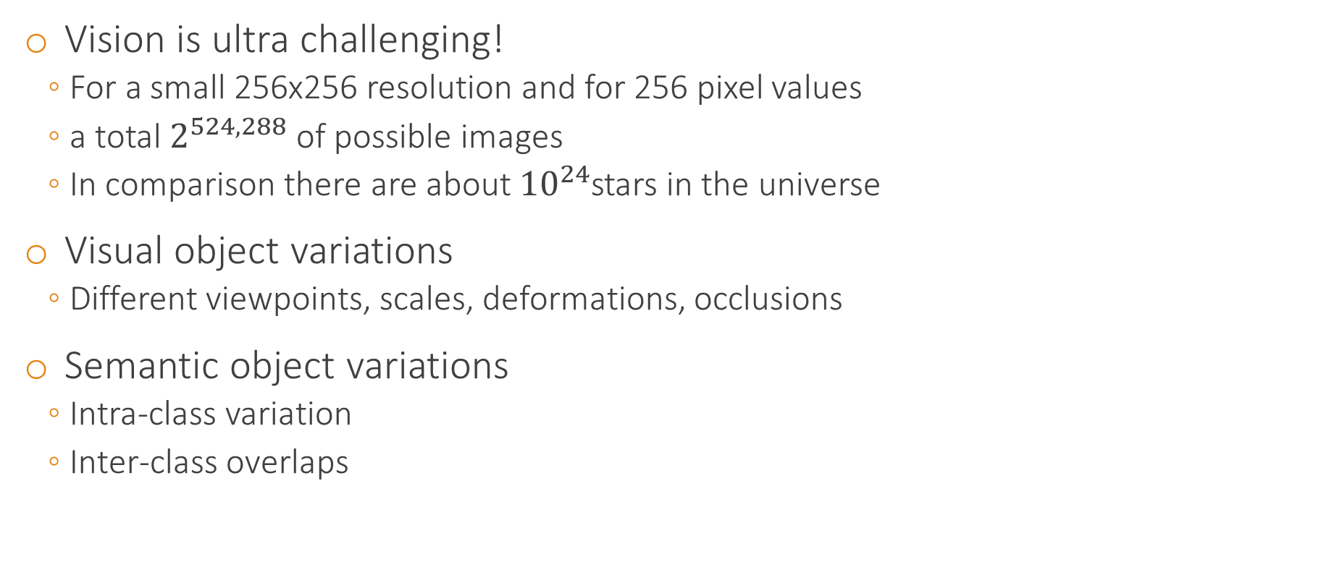
Why should we be impressed?
Vision is ultra challenging!
For a small 256x256 resolution and for 256 pixel values
a total $2^{524,288}$ of possible images
In comparison there are about ${10}^{24}$stars in the universe
Visual object variations
Different viewpoints, scales, deformations, occlusions
Semantic object variations
Intra-class variation
Inter-class overlaps

Slide 12
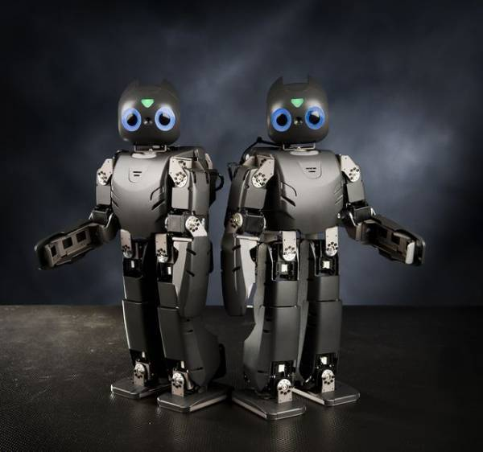
Deep Learning in Robotics

Slide 13
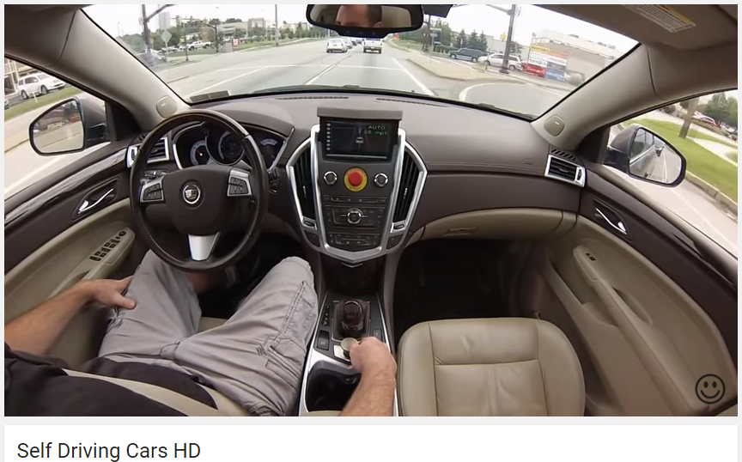
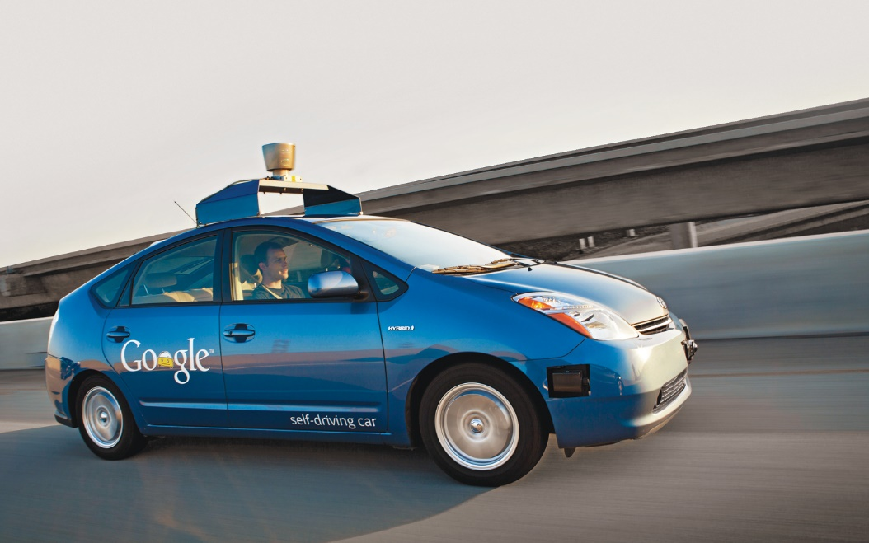
Self-driving cars
Click to go to the video in Youtube

Slide 14
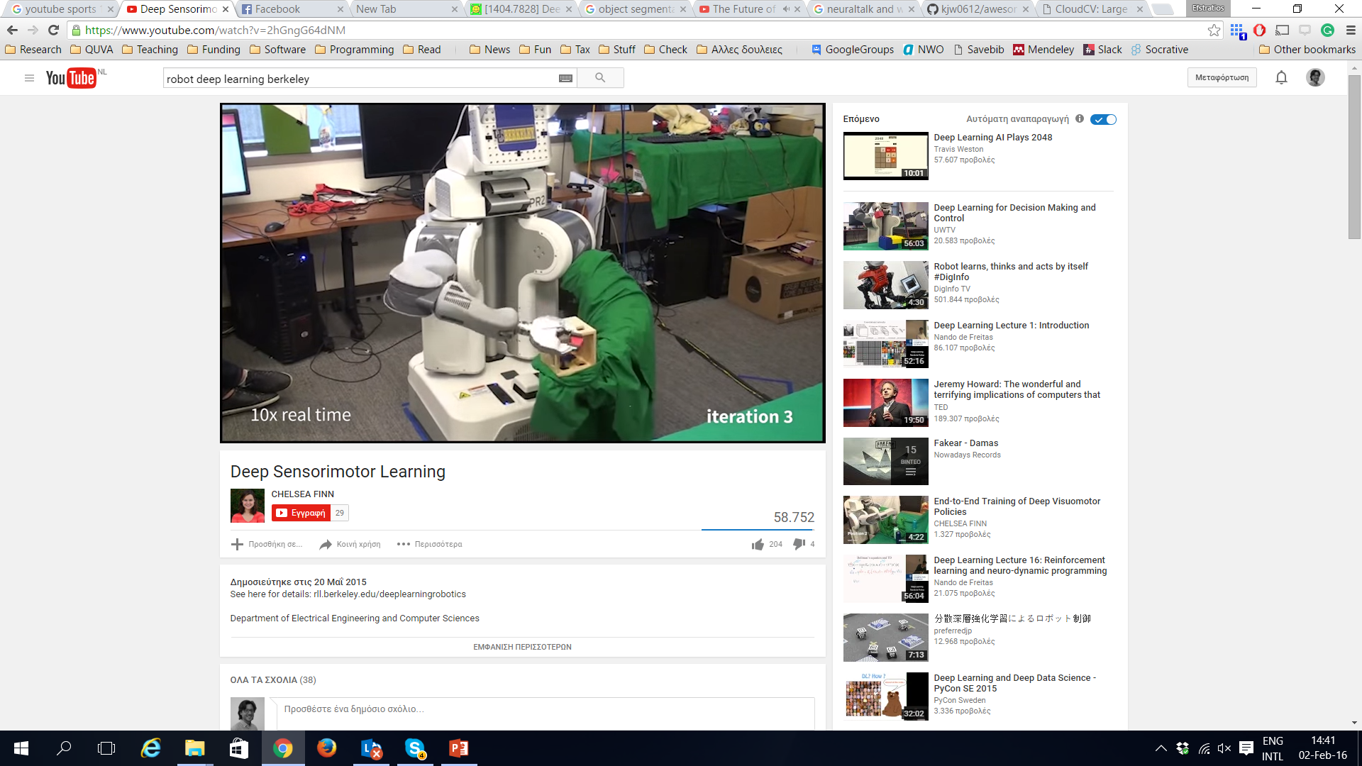
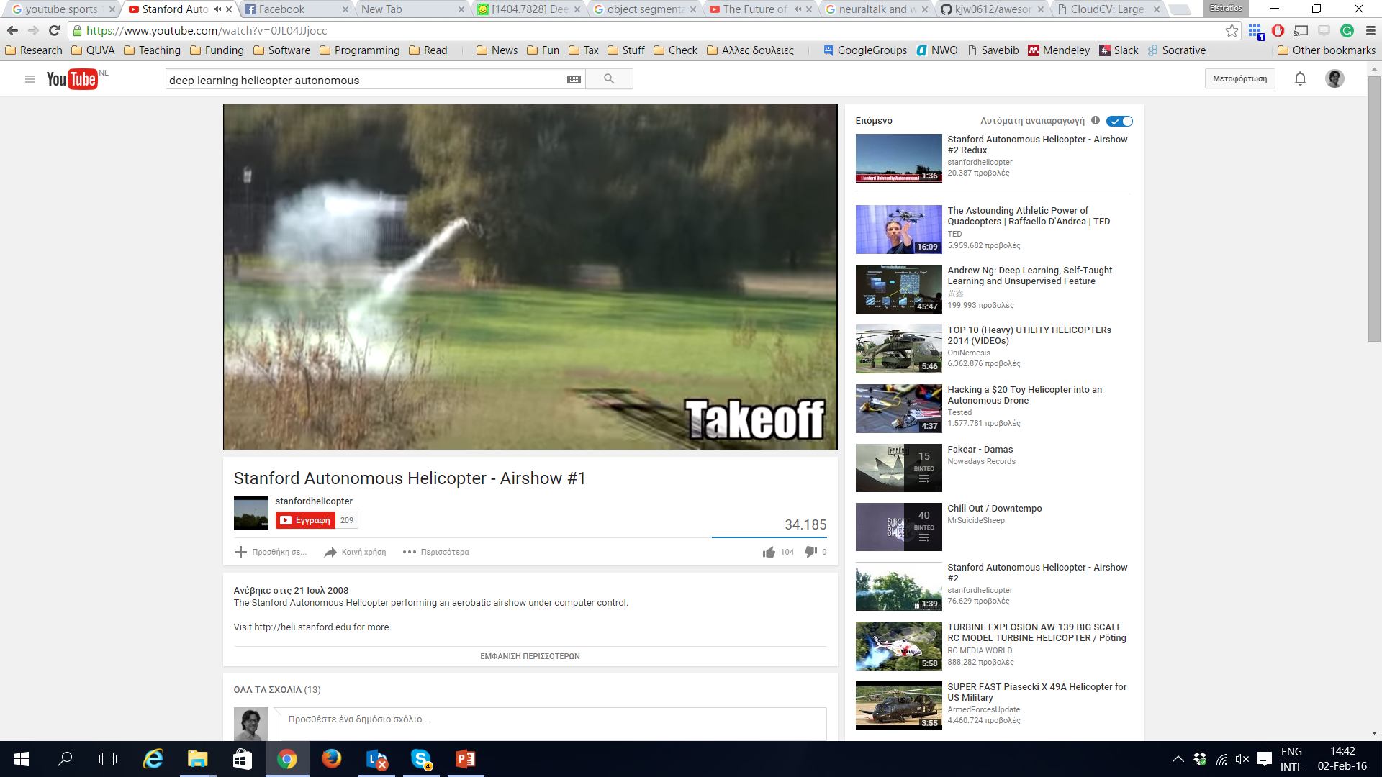
Drones and robots
Click to go to the video in Youtube
Click to go to the video in Youtube

Slide 15

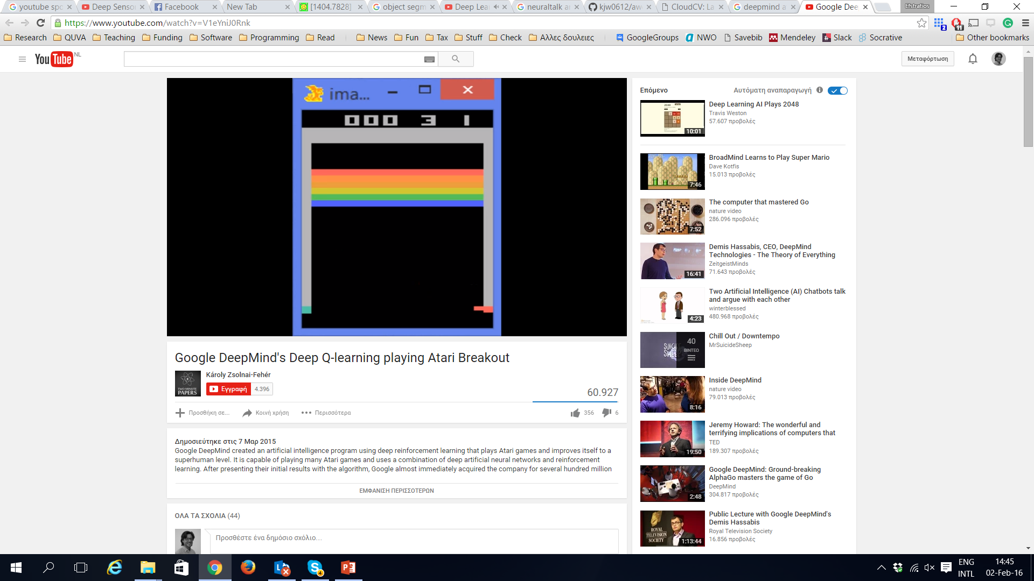
Game AI
Click to go to the video in Youtube

Slide 16
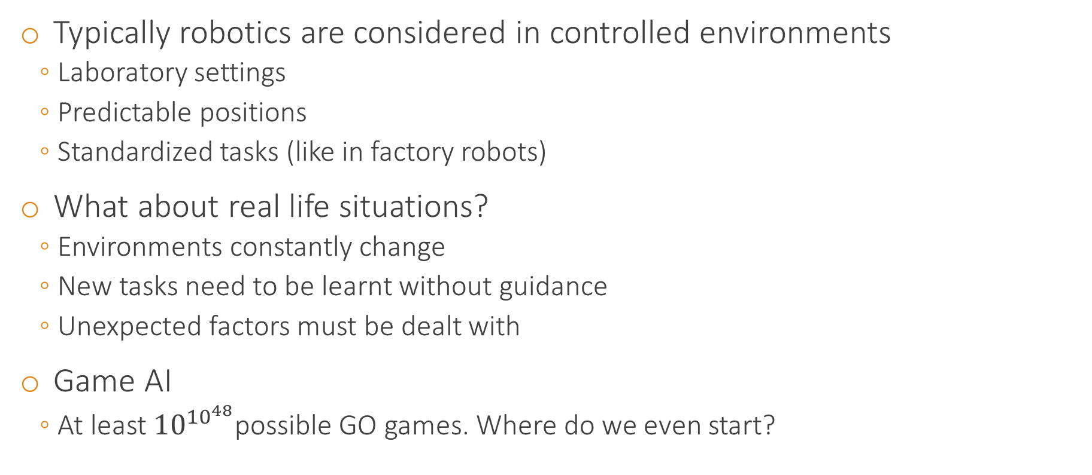
Why should we be impressed?
Typically robotics are considered in controlled environments
Laboratory settings
Predictable positions
Standardized tasks (like in factory robots)
What about real life situations?
Environments constantly change
New tasks need to be learnt without guidance
Unexpected factors must be dealt with
Game AI
At least ${10}^{{10}^{48}}$possible GO games. Where do we even start?

Slide 17
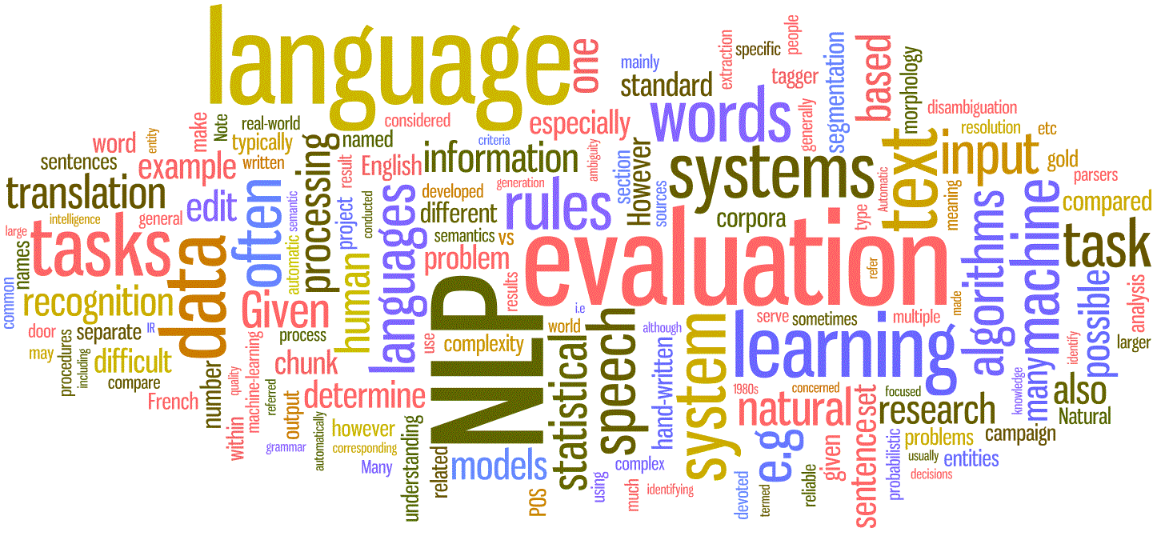
Deep Learning in NLP and Speech

Slide 18
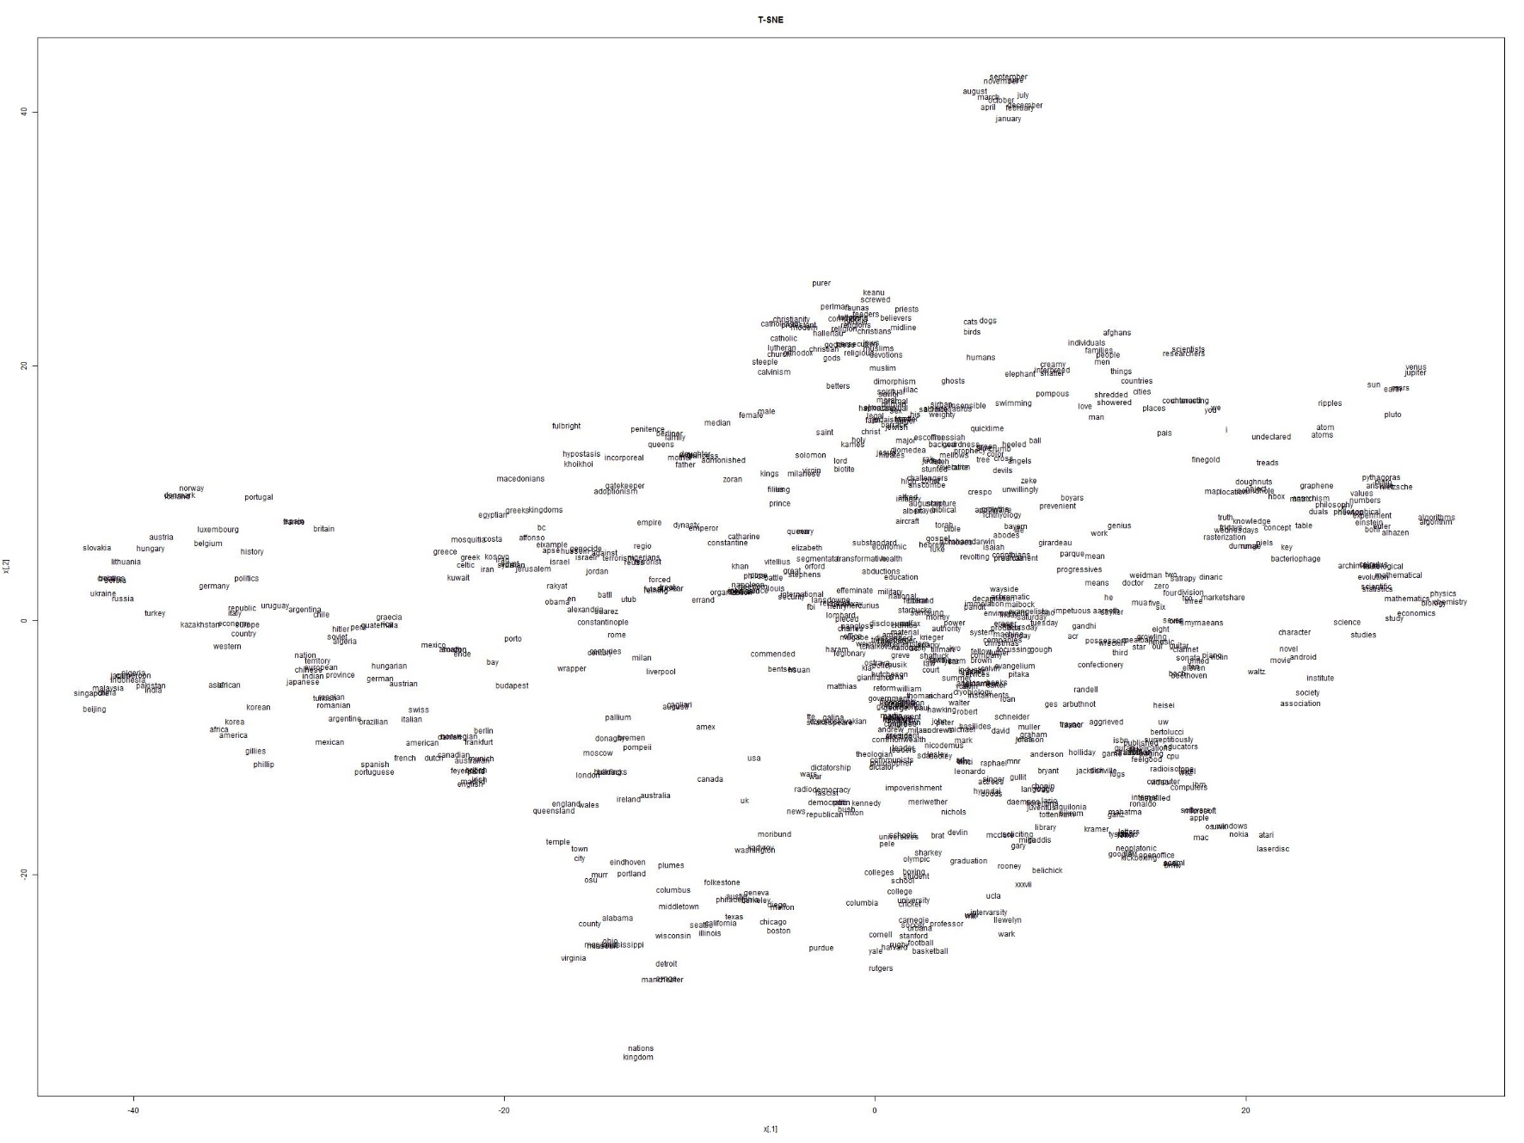
Word and sentence representations

Slide 19


Speech recognition and Machine translation

Slide 20
Why should we be impressed?
NLP is an extremely complex task
synonymy (“chair”, “stool” or “beautiful”, “handsome”)
ambiguity (“I made her duck”, “Cut to the chase”)
NLP is very high dimensional
assuming 150K english words, we need to learn 150K classifiers
with quite sparse data for most of them
Beating NLP feels the closest to achieving true AI
although true AI probably goes beyond NLP, Vision, Robotics, … alone

Slide 21

Deep Learning in the arts

Slide 22
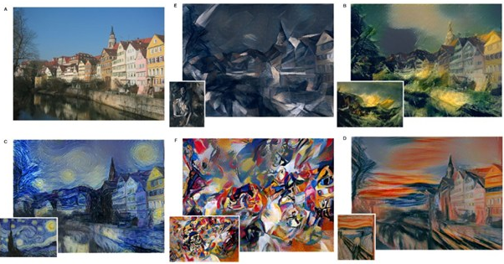
Imitating famous painters

Slide 23
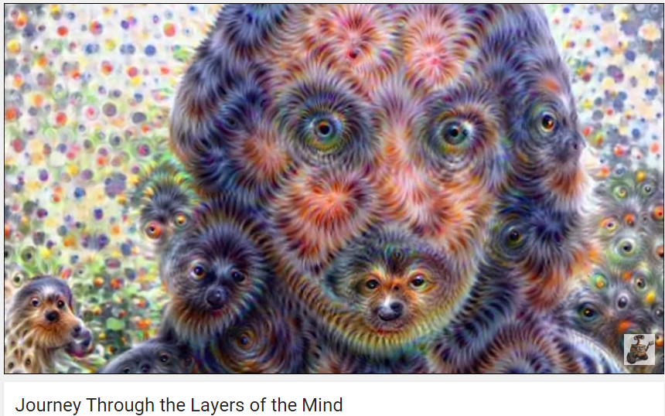
Or dreaming …
Click to go to the video in Youtube

Slide 24
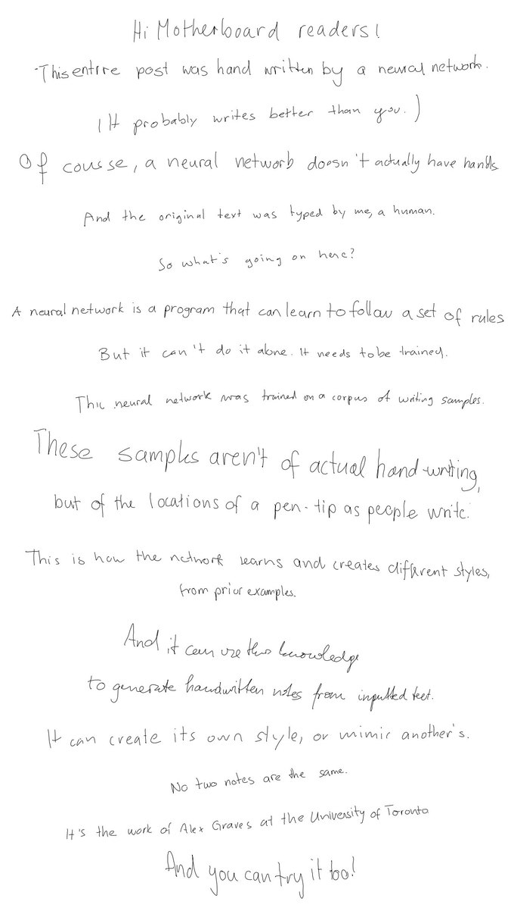
Handwriting
Click to go to the website

Slide 25
Why should we be impressed?
Music, painting, etc. are tasks that are uniquely human
Difficult to model
Even more difficult to evaluate (if not impossible)
If machines can generate novel pieces even remotely resembling art, they must have understood something about “beauty”, “harmony”, etc.
Have they really learned to generate new art, however?
Or do they just fool us with their tricks?

Slide 26
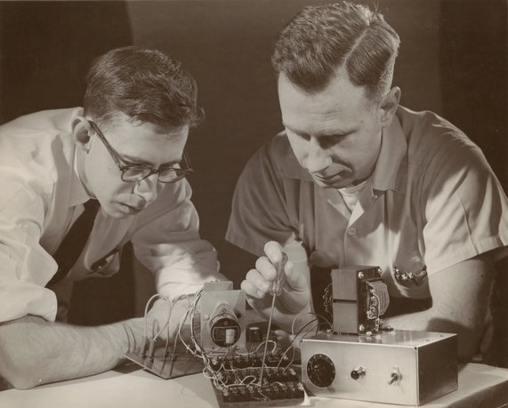
A brief history of Neural Networks & Deep Learning
Charles W. Wightman
Frank Rosenblatt

Slide 27
First appearance (roughly)
Backpropagation, Rumelhart, Hinton and Williams
OCR, LeCun, Bottou, Bengio and Haffner
Alexnet, LeCun, Bottou, Bengio and Haffner
Deep Learning, Hinton, Osindero, Teh
LSTM, Hochreiter and Schmidhuber
Imagenet, Deng et al.
Perceptrons, Rosenblatt
Resnet (154 layers), MSRA
Backpropagation, Linnainmaa
Perceptrons, Minsky and Papert
Backpropagation, Werbos
Adaline, Widrow and Hoff
GO, Deepmind
1958
1960
1969
1970
1974
1986
1997
1998
2006
2009
2013
2015
today

Slide 28
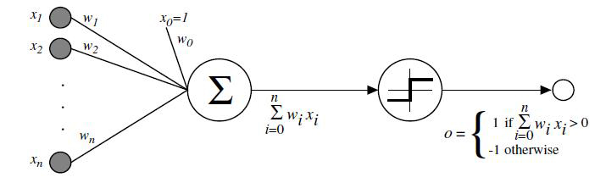
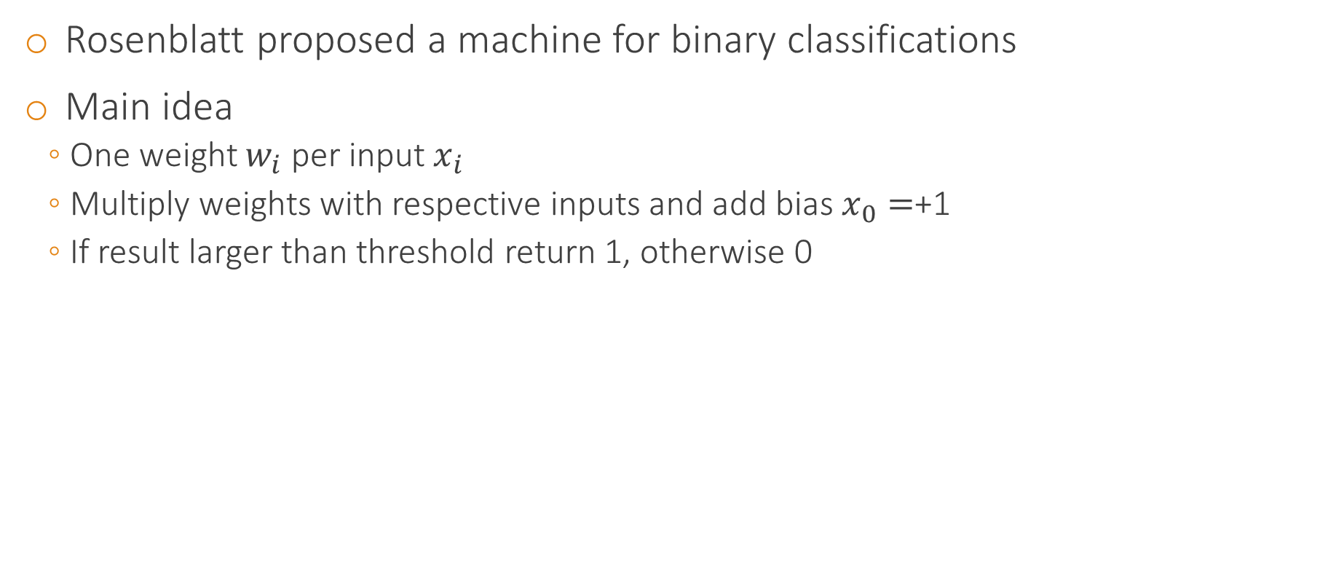
Perceptrons
Rosenblatt proposed a machine for binary classifications
Main idea
One weight $w_{i}$ per input $x_{i}$
Multiply weights with respective inputs and add bias $x_{0}=$+1
If result larger than threshold return 1, otherwise 0

Slide 29
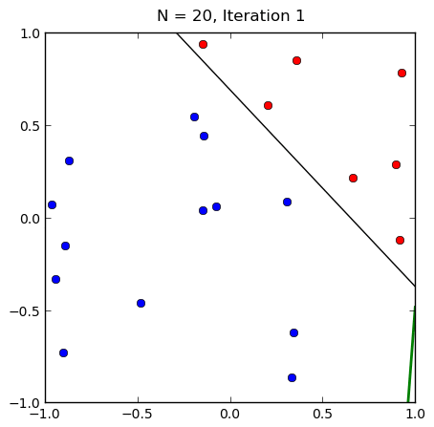
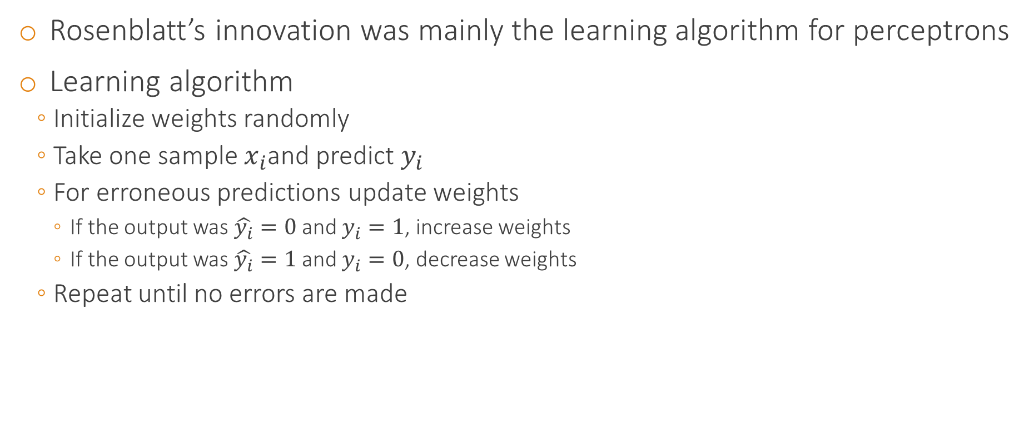
Training a perceptron
Rosenblatt’s innovation was mainly the learning algorithm for perceptrons
Learning algorithm
Initialize weights randomly
Take one sample $x_{i}$and predict $y_{i}$
For erroneous predictions update weights
If the output was $\hat{y_{i}}=0$ and $y_{i}=1$, increase weights
If the output was $\hat{y_{i}}=1$ and $y_{i}=0$, decrease weights
Repeat until no errors are made

Slide 30
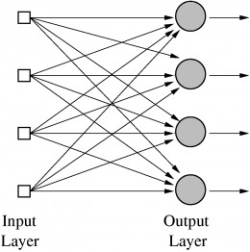
From a perceptron to a neural network
One perceptron = one decision
What about multiple decisions?
E.g. digit classification
Stack as many outputs as the possible outcomes into a layer
Neural network
Use one layer as input to the next layer
Multi-layer perceptron (MLP)

Slide 31
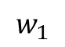
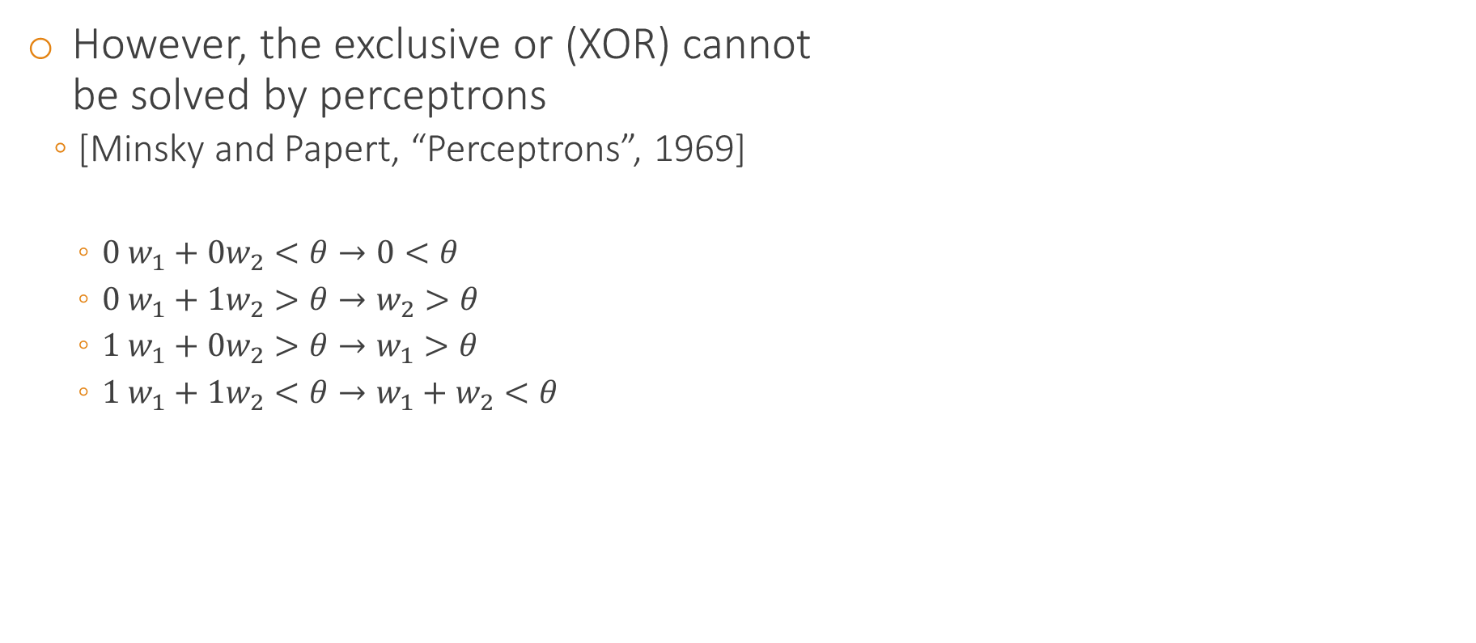
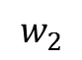
XOR & Multi-layer Perceptrons
Output
However, the exclusive or (XOR) cannot be solved by perceptrons
[Minsky and Papert, “Perceptrons”, 1969]
$0 w_{1}+0w_{2}<θ→0<θ$
$0 w_{1}+1w_{2}>θ→w_{2}>θ$
$1 w_{1}+0w_{2}>θ→w_{1}>θ$
$1 w_{1}+1w_{2}<θ→{w_{1}+w}_{2}<θ$
$$w_{1}$$
$$w_{2}$$
Input 1
Input 2
Input 1 | Input 2 | Output
1 | 1 | 0
1 | 0 | 1
0 | 1 | 1
0 | 0 | 0

Slide 32
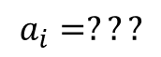
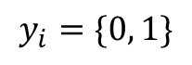
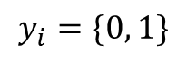
Minsky & Multi-layer perceptrons
$$a_{i}=???$$
Interestingly, Minksy never said XOR cannot be solved by neural networks
Only that XOR cannot be solved with 1 layer perceptrons
Multi-layer perceptrons can solve XOR
9 years earlier Minsky built such a multi-layer perceptron
However, how to train a multi-layer perceptron?
Rosenblatt’s algorithm not applicable, as it expects to know the desired target
For hidden layers we cannot know the desired target
$$y_{i}=\{0, 1\}$$
$$y_{i}=\{0, 1\}$$

Slide 33
The “AI winter” despite notable successes
Backpropagation, Rumelhart, Hinton and Williams
OCR, LeCun, Bottou, Bengio and Haffner
Alexnet, LeCun, Bottou, Bengio and Haffner
Deep Learning, Hinton, Osindero, Teh
LSTM, Hochreiter and Schmidhuber
Imagenet, Deng et al.
Perceptrons, Rosenblatt
Resnet (154 layers), MSRA
Perceptrons, Minsky and Papert
Backpropagation, Linnainmaa
Adaline, Widrow and Hoff
Backpropagation, Werbos
GO, Deepmind
1958
1960
1969
1970
1974
1986
1997
1998
2006
2009
2013
2015
today

Slide 34
“AI winter” starts
What everybody though: “If a perceptron cannot even solve XOR, why bother?
Also, the exaggeration did not help (walking, talking robots were promised in the 60s)
As results were never delivered, further funding was slushed, neural networks were damned and AI in general got discredited
“The AI winter is coming”
Still, a few people persisted
Significant discoveries were made, that laid down the road for today’s achievements

Slide 35
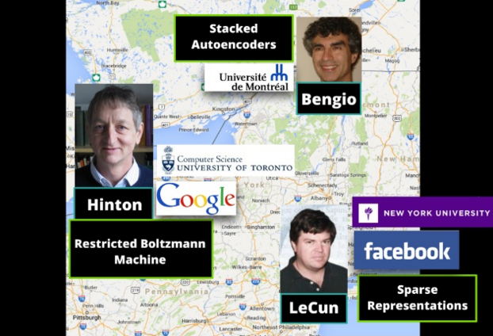
The believers

Slide 36
Backpropagation
Learning multi-layer perceptrons now possible
XOR and more complicated functions can be solved
Efficient algorithm
Process hundreds of example without a sweat
Allowed for complicated neural network architectures
Backpropagation still is the backbone of neural network training today
Digit recognition in cheques (OCR) solved before the 2000

Slide 37
Recurrent networks
What
about
inputs
that
appear
in
Traditional networks are “too plain”
Static Input → Processing → Static Output
What about dynamic input
Temporal data, Language, Sequences
Memory is needed to “remember” state changes
Recurrent feedback connections
What kind of memory
Long, Short?
Both! Long-short term memory networks (LSTM), Schmidhuber 1997
sequences,
such
as
Could
neural
text?
a
network
handle
such
modalities?

Slide 38
The thaw of the “AI winter”
Backpropagation, Rumelhart, Hinton and Williams
OCR, LeCun, Bottou, Bengio and Haffner
Alexnet, LeCun, Bottou, Bengio and Haffner
Deep Learning, Hinton, Osindero, Teh
LSTM, Hochreiter and Schmidhuber
Imagenet, Deng et al.
Perceptrons, Rosenblatt
Resnet (154 layers), MSRA
Perceptrons, Minsky and Papert
Backpropagation, Linnainmaa
Adaline, Widrow and Hoff
Backpropagation, Werbos
GO, Deepmind
1958
1960
1969
1970
1974
1986
1997
1998
2006
2009
2013
2015
today

Slide 39
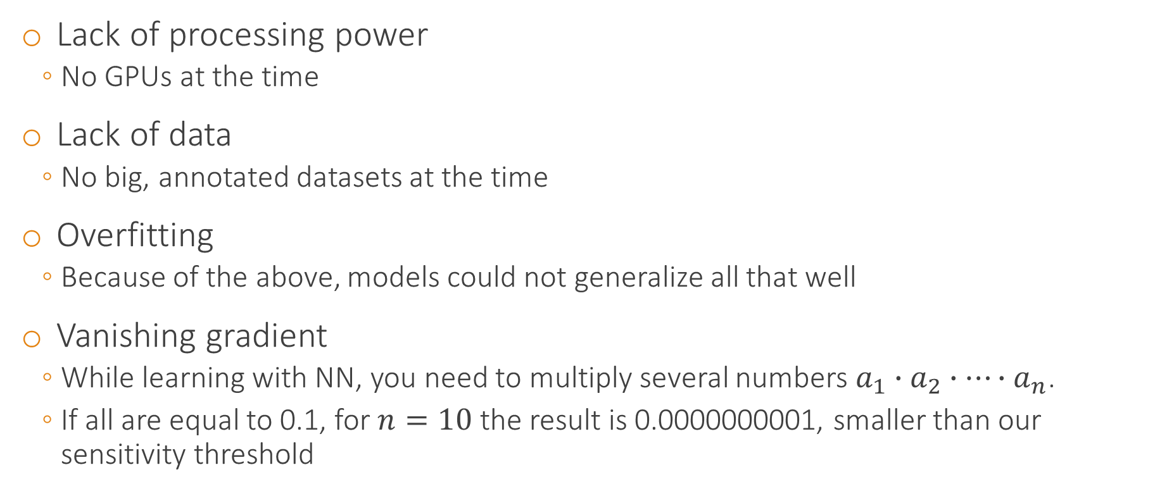
Neural Network and Deep Learning problems
Lack of processing power
No GPUs at the time
Lack of data
No big, annotated datasets at the time
Overfitting
Because of the above, models could not generalize all that well
Vanishing gradient
While learning with NN, you need to multiply several numbers $a_{1}∙a_{2}∙…∙a_{n}$.
If all are equal to 0.1, for $n=10$ the result is 0.0000000001, smaller than our sensitivity threshold

Slide 40
Despite Backpropagation …
Experimentally, training multi-layer perceptrons was not that useful
Accuracy didn’t improve with more layers
The inevitable question
Are 1-2 hidden layers the best neural networks can do?
Or is it that the learning algorithm is not really mature yet

Slide 41
Deep Learning arrives
Layer-by-layer training
The training of each layer individually is an easier undertaking
Training multi-layered neural networks became easier
Per-layer trained parameters initialize further training using contrastive divergence
Training layer 3
Training layer 2
Training layer 1

Slide 42
Deep Learning Renaissance
Backpropagation, Rumelhart, Hinton and Williams
OCR, LeCun, Bottou, Bengio and Haffner
Alexnet, LeCun, Bottou, Bengio and Haffner
Deep Learning, Hinton, Osindero, Teh
LSTM, Hochreiter and Schmidhuber
Resnet (154 layers), MSRA
Perceptrons, Rosenblatt
Imagenet, Deng et al.
Perceptrons, Minsky and Papert
Backpropagation, Linnainmaa
Adaline, Widrow and Hoff
Backpropagation, Werbos
GO, Deepmind
1958
1960
1969
1970
1974
1986
1997
1998
2006
2009
2013
2015
today

Slide 43
More data, more …
In 2009 the Imagenet dataset was published [Deng et al., 2009]
Collected images for each term of Wordnet (100,000 classes)
Tree of concepts organized hierarchically
“ambulance”, “Dalmatian dog”, “Egyptian cat”, …
About 16 million images annotated by humans
Imagenet Large Scale Visual Recognition Challenge (ILSVRC)
1 million images
1,000 classes
Top-5 and top-1 error measured

Slide 44
Alexnet
In 2013 Krizhevsky, Sutskever and Hinton re-implemented [Krizhevsky2013] a convolutional neural network [LeCun1998]
Trained on Imagenet
Two GPUs were used for the implementation
Additional tricks
Rectified Linear Units (ReLU) instead of sigmoid or tanh
Dropout
Data augmentation
In the 2013 Imagenet Workshop a legendary turmoil
Blasted competitors by an impressive 16% top-5 error
Second best around 26%
Most didn’t even think of NN as remotely competitive

Slide 45
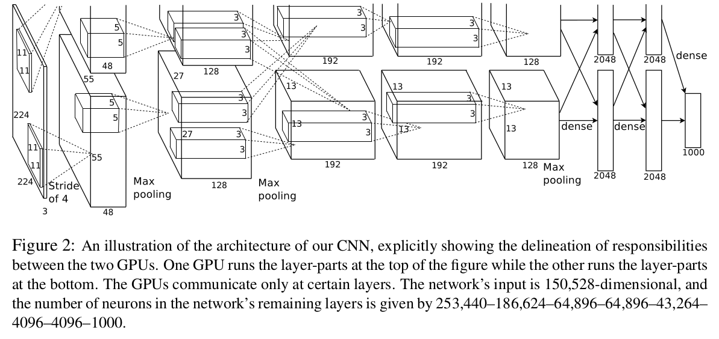
Alexnet architecture

Slide 46
Deep Learning Golden Era
Backpropagation, Rumelhart, Hinton and Williams
OCR, LeCun, Bottou, Bengio and Haffner
Alexnet, LeCun, Bottou, Bengio and Haffner
Deep Learning, Hinton, Osindero, Teh
Resnet (154 layers), MSRA
Perceptrons, Rosenblatt
LSTM, Hochreiter and Schmidhuber
Imagenet, Deng et al.
Perceptrons, Minsky and Papert
Backpropagation, Linnainmaa
Adaline, Widrow and Hoff
Backpropagation, Werbos
GO, Deepmind
1958
1960
1969
1970
1974
1986
1997
1998
2006
2009
2013
2015
today

Slide 47
The today
Deep Learning is almost everywhere
Object classification
Object detection, segmentation, pose estimation
Image captioning, question answering
Machine translation
Speech recognition
Robotics
Some strongholds
Action classification, action detection
Object retrieval
Object tracking

Slide 48
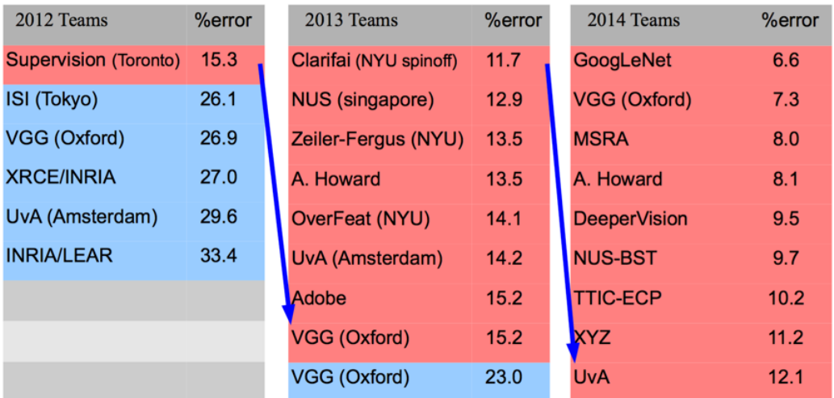
The ILSVC Challenge over the last three years
CNN based, non-CNN based
Figures taken from Y. LeCun’s CVPR 2015 plenary talk

Slide 49
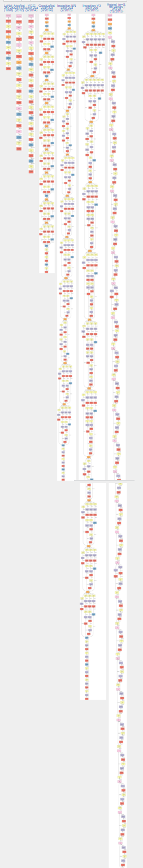
Latest 2015 ILSVC Challenge
Alexnet, 2012
Microsoft Research Asia won the competition with a legendary 150-layered network
Almost superhuman accuracy: only 3.5% error
In comparison last year’s GoogLeNet had 22 layers
2014
2015

Slide 50
Google Deepmind’s AlphaGO
Last week Google Deepmind beat the European champion in GO
GO is the last stronghold where humans still beat the computers
1,000,000,000,000,000,000,000,000,000,000,000,000,000,000,000,000,000,000,000,000,000,000,000,000,000,000,000,000,000,000,000,000,000,000,000,000,000,000,000,000,000,000,000,000,000,000,000,000,000,000,000,000,000,000,000,000,000 possible positions
Still, doubts are casted whether the game has been “mastered”

Slide 51
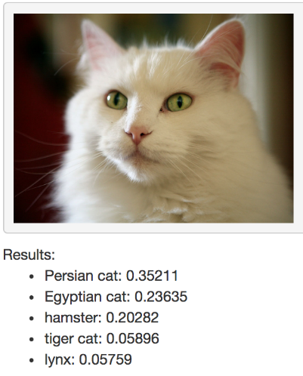
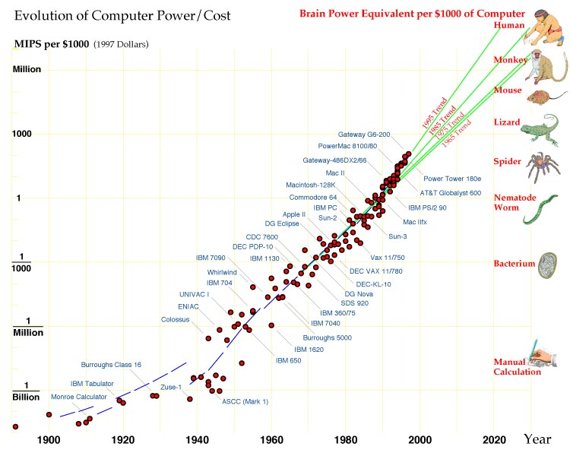
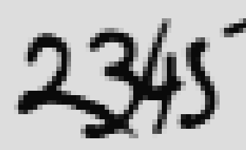
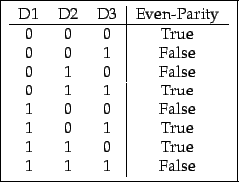
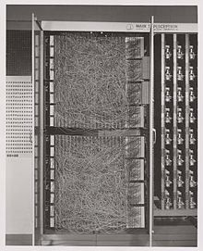
So, why now?
Datasets of everything (captions, question-answering, …), reinforced learning, ???
1. Better hardware
???
Imagenet: 1,000 classes from real images, 1,000,000 images
Object recognition with CNN
OCR with CNN
Bank cheques
Backpropagation
Loglinear
Perceptron
Parity, negation problems
Mark I Perceptron
Potentiometers implement perceptron weights
2. Bigger data

Slide 52
So, why now? (2)
Better hardware
Bigger data
Better regularization methods, such as dropout
Better optimization protocols, such as batch normalization

Slide 53

Deep Learning: The What and Why

Slide 54
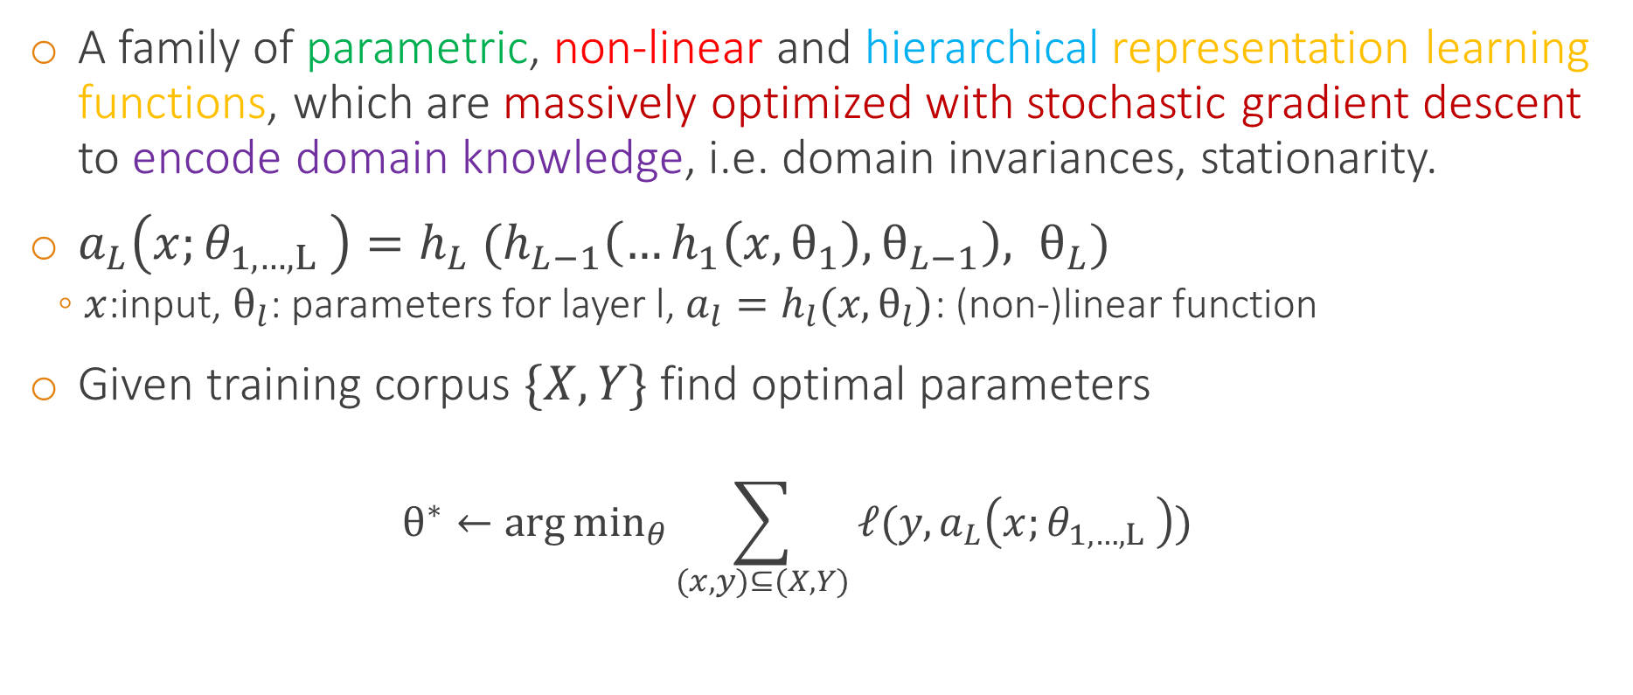
Long story short
A family of parametric, non-linear and hierarchical representation learning functions, which are massively optimized with stochastic gradient descent to encode domain knowledge, i.e. domain invariances, stationarity.
$a_{L}\left(x;θ_{1,…,L} \right)=h_{L} (h_{L−1}\left(…h_{1}\left(x,θ_{1}\right),θ_{L−1}\right), θ_{L})$
$x$:input, $θ_{l}$: parameters for layer l, $a_{l}=h_{l}(x,θ_{l})$: (non-)linear function
Given training corpus $\{X, Y\}$ find optimal parameters
$$θ^{∗}←\arg{\min_{θ}{\sum_{(x,y)⊆(X, Y)}{ℓ(y,a_{L}\left(x;θ_{1,…,L} \right))}}}$$

Slide 55
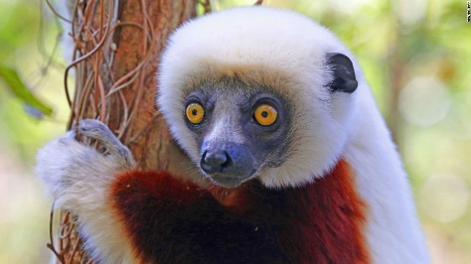
Learning Representations & Features
Traditional pattern recognition
End-to-end learning → Features are also learned from data
Hand-crafted Feature Extractor
Separate Trainable Classifier
“Lemur”
Trainable Feature Extractor
Trainable Classifier
“Lemur”

Slide 56
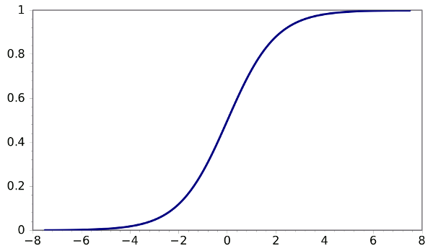
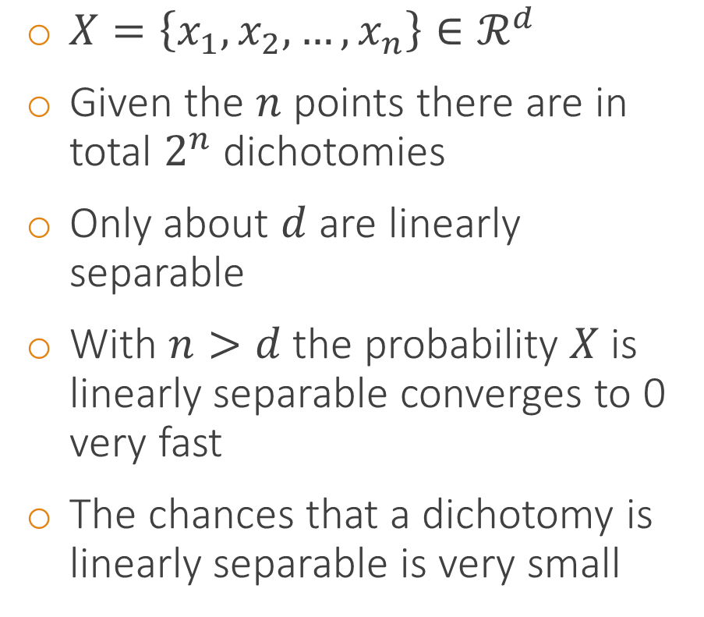
Non-separability of linear machines
$X=\left\{x_{1},x_{2},…,x_{n}\right\}∈ℛ^{d}$
Given the $n$ points there are in total $2^{n}$ dichotomies
Only about $d$ are linearly separable
With $n>d$ the probability $X$ is linearly separable converges to 0 very fast
The chances that a dichotomy is linearly separable is very small
Probability of linear separability
P=N
#samples

Slide 57
Non-linearizing linear machines
Most data distributions and tasks are non-linear
A linear assumption is often convenient, but not necessarily truthful
Problem: How to get non-linear machines without too much effort?
Solution: Make features non-linear
What is a good non-linear feature?
Polynomials and cross products of the input
Explicit design of features (SIFT, HOG)?

Slide 58
Good features
High-dimensional data lie in lower dimensional manifolds
Goal: discover these lower dimensional manifolds
These manifolds are most probably highly non-linear
Hypothesis (1): By computing the coordinates of the input (e.g. face image) to this non-linear manifold data become separable
Hypothesis (2): Semantically similar things lie closer together than semantically dissimilar things

Slide 59
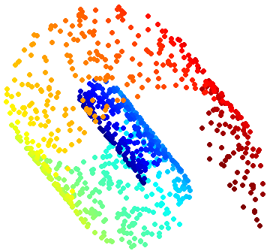
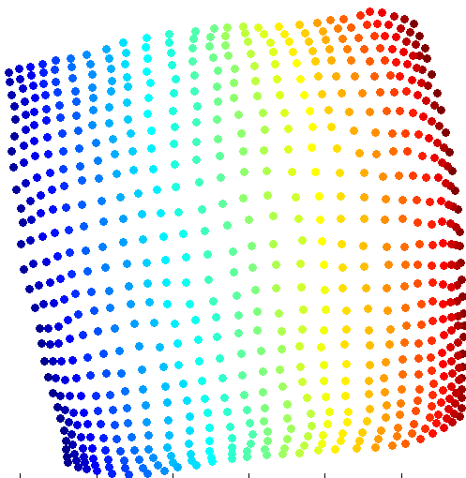
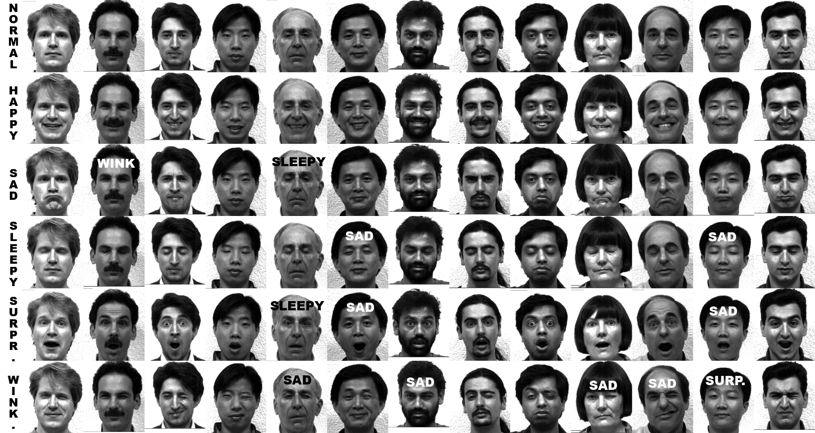

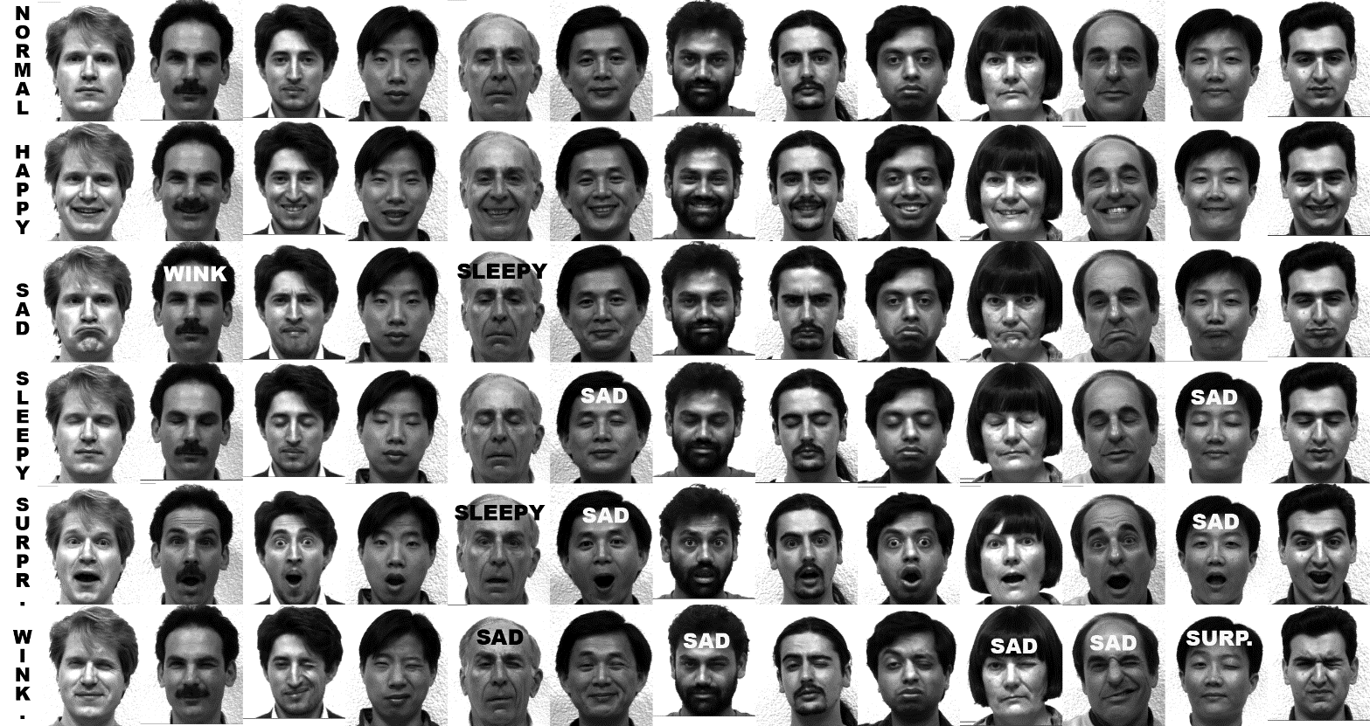
Feature manifold example
Raw data live in huge dimensionalities
Semantically meaningful raw data prefer lower dimensional manifolds
Which still live in the same huge dimensionalities
Can we discover this manifold to embed our data on?
Dimension 1
Dimension n
Dimension 2

Slide 60
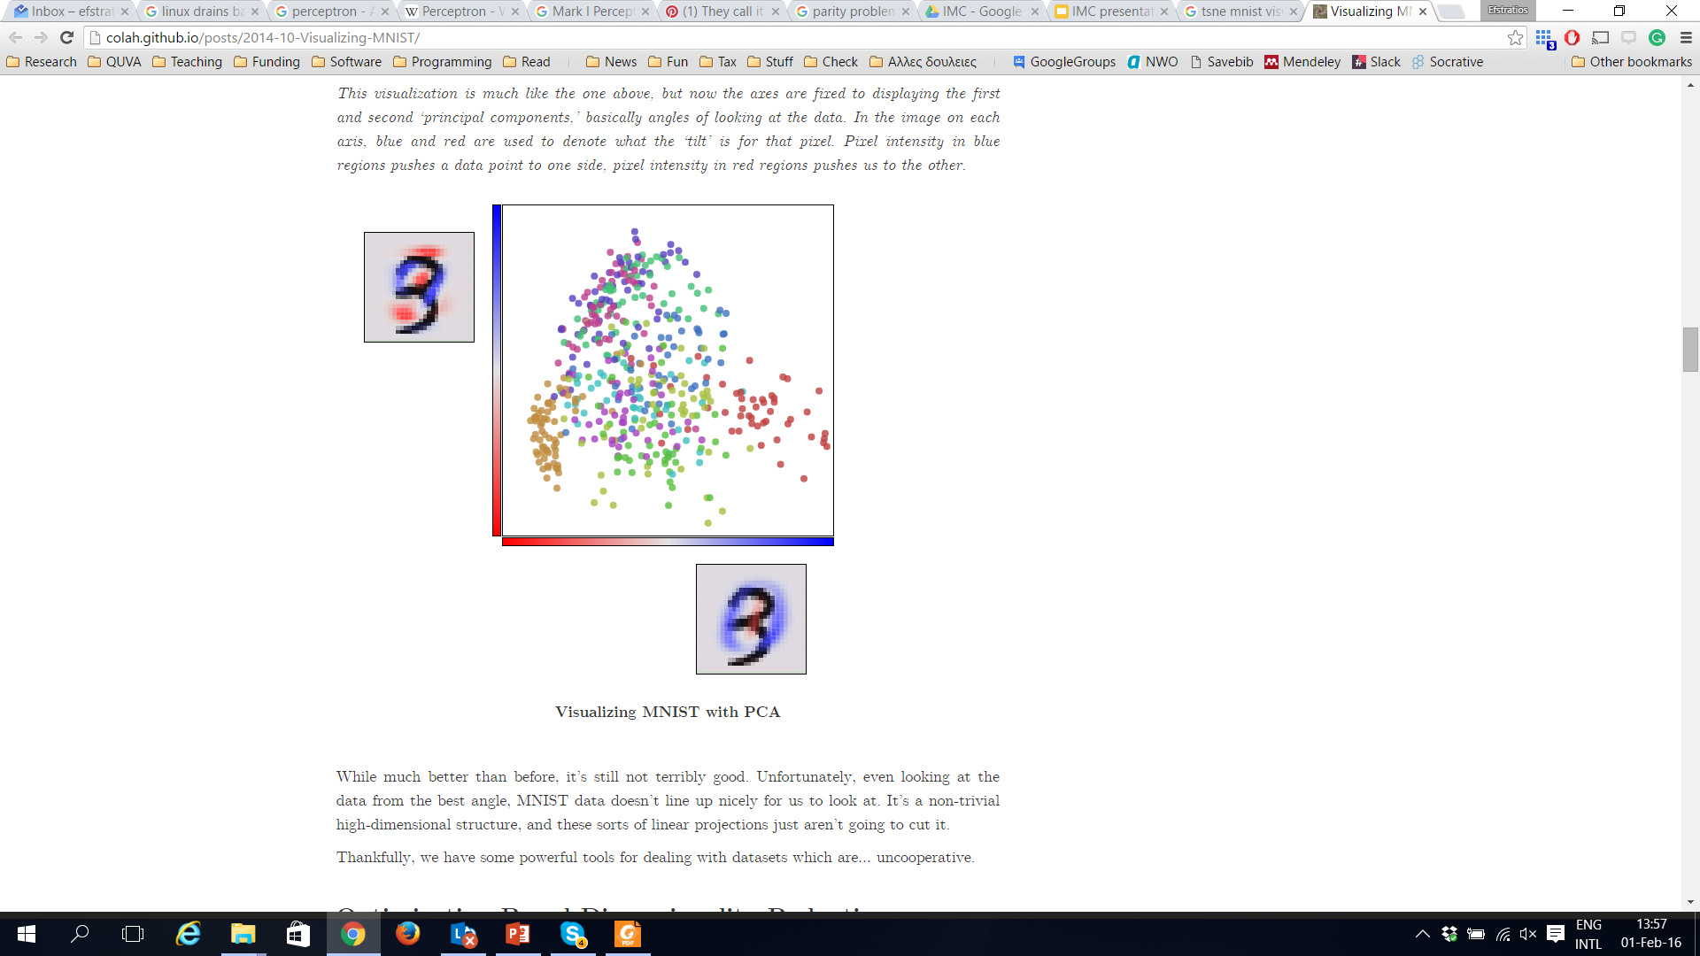
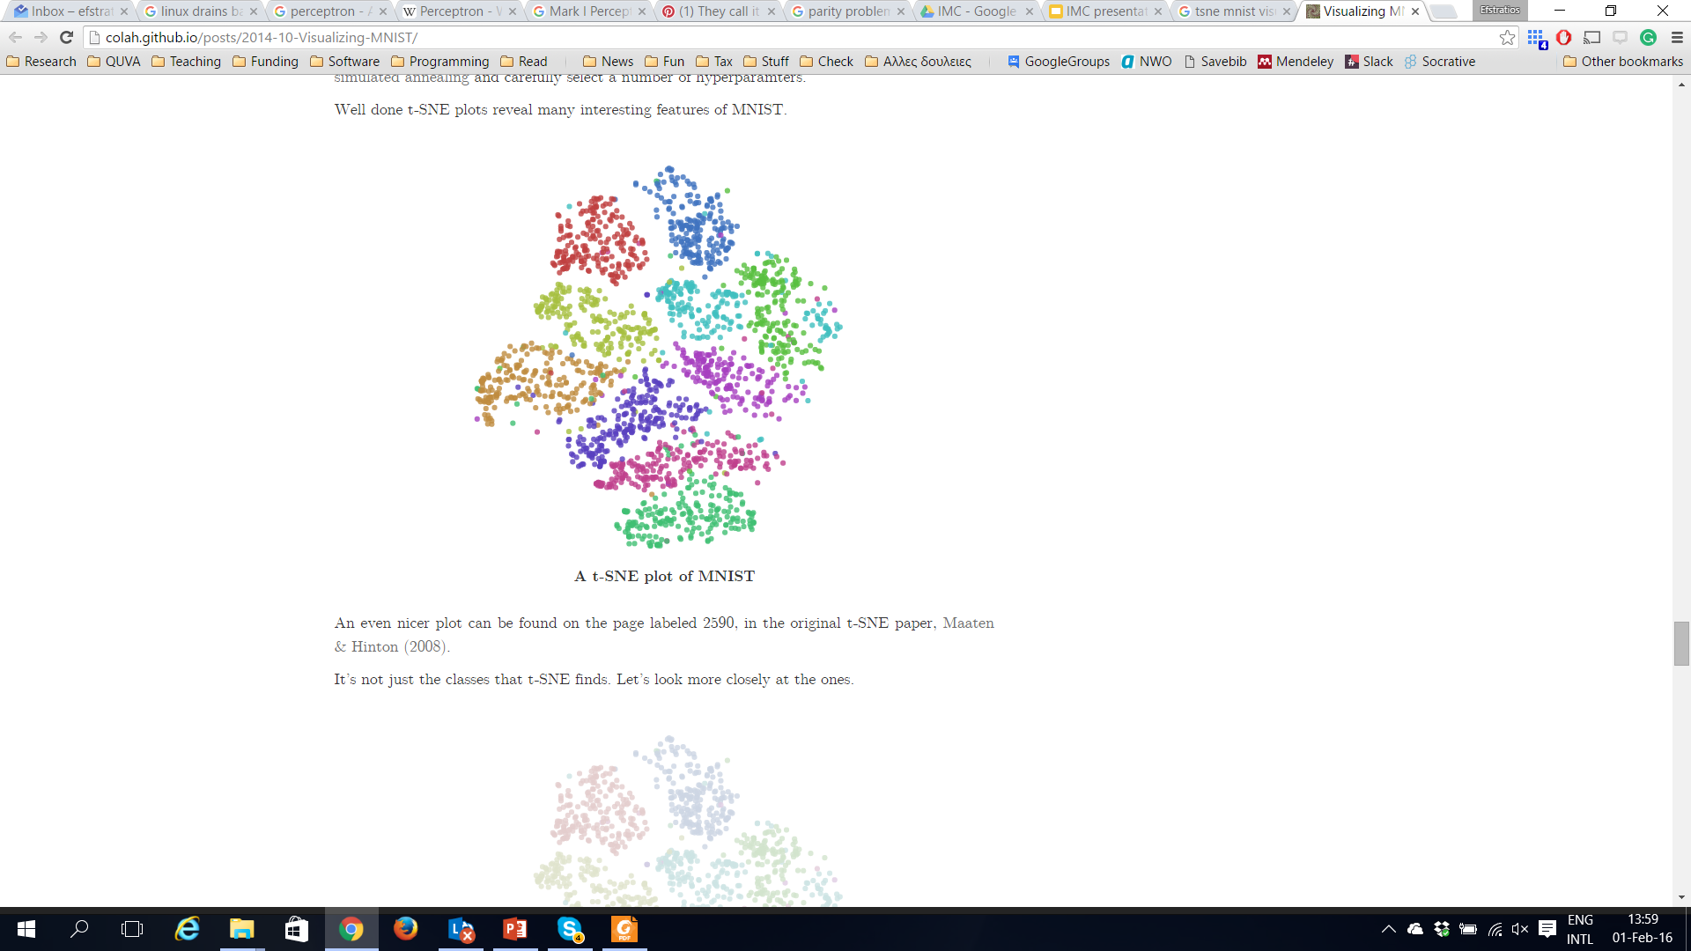

The digits manifolds
There are good features and bad features, good manifold representations and bad manifold representations
28 pixels x 28 pixels = 784 dimensions
PCA manifold (Two eigenvectors)
t-SNE manifold

Slide 61
End-to-end learning of feature hierarchies
A pipeline of successive modules
Each module’s output is the input for the next module
Modules produce features of higher and higher abstractions
Initial modules capture low-level features (e.g. edges or corners)
Middle modules capture mid-level features (e.g. circles, squares, textures)
Last modules capture high level, class specific features (e.g. face detector)
Preferably, input as raw as possible
Pixels for computer vision, words for NLP
Training
Training
Training
Initial modules
Middle modules
Last modules
“Lemur”

Slide 62


Why learn the features?
Manually designed features
Often take a lot of time to come up with and implement
Often take a lot of time to validate
Often they are incomplete, as one cannot know if they are optimal for the task
Learned features
Are easy to adapt
Very compact and specific to the task at hand
Given a basic architecture in mind, it is relatively easy and fast to optimize
Time spent for designing features now spent for designing architectures
vs.

Slide 63

Types of learning
Reconstruct this image
Is this a dog or a cat?
Supervised learning
(Convolutional) neural networks
Unsupervised learning
Autoencoders, layer-by-layer training
Self-supervised learning
A mix of supervised and unsupervised learning
Reinforcement learning
Learn by cause and effect from your environment

Slide 64
Deep architectures
Feedforward
(Convolutional) neural networks
Feedback
Deconvolutional networks
Bi-directional
Deep Boltzmann Machines, stacked autoencoders
Sequence based
RNNs, LSTMs

Slide 65
Convolutional networks in a nutshell
Dog
or Cat?
Output layers
Is this a dog or a cat?
Hidden layers
Input layer

Slide 66
Recurrent networks in a nutshell
Output:
“To”
“be”
“or”
“not”
…
Output t
LSTM
LSTM
LSTM
LSTM
LSTM
Previous memory
Previous memory
Previous memory
…
Input t
Memory from previous state
Current input
t=0
Current input
t=1
Current input
t=2
Current input
T=3
…

Slide 67
Deconvolutional networks
Convolutional network
Deconvolutional network

Slide 68

Autoencoders in a nutshell
Encoding
Decoding

Slide 69

Theory of Deep Learning

Slide 70

Deep Learning Approximation Theory
Deep Networks are universal approximators
Theorem Let $ρ()$ be a bounded, non-constant continuous function. Let $I_{m}$ denote the $m$-dimensional hypercube, and ${C(I}_{m})$ denote the space of continuous functions on and $ε>0$, there exists N>0 and $υ_{i},w_{i},b_{i}, i=1, …, N$ such that $F\left(x\right)=\sum_{i≤N}{υ_{i}ρ(w_{i}^{T}x+b_{i})}$ satisfies $\sup_{x∈I_{m}}\left|f\left(x\right)−F\left(x\right)\right|<{ε}$.
Even a single hidden layer can approximate any function and represent any locally linear boundary.
Of course, the theorem does not say what is the architecture or how to find the optimal parameters

Slide 71

Deep Learning Estimation Theory
Theorem [Barron 92’] The mean integrated square error between the estimated network is bounded by $O\left(\frac{C_{f}^{2}}{N}\right)+O\left(\frac{Nm}{K}\log{K}\right)$, where K is the number of training points, $N$ is the number of neurons, $m$ is the input dimension, and $C_{f}$ measures the global smoothness of $f$.
Combines approximation and estimation error
Does not explain the relation between online or stochastic optimization and batch normalization
Does not relate the generalization error with the network architecture

Slide 72
VC dimensions
VC dimension. The capacity of the model is measured by the number of configurations that it can shatter
[P. Bartlett et al., “Vapnik-Chernovenkis Dimension of Neural Nets”]
If the capacity of the network is measured by the number of pieces in a piecewise linear approximation, the capacity increases with depth
[Montufar, Pascanu et al. 2014]
Upper bound on the empirical risk of deep networks
Do not explain why deep networks generalize that well
Bounds are often not tight enough in practice, although this is the same for many other models too

Slide 73
So, why deep and not shallow?
Although with two-layer (shallow) network, we can approximate all possible functions
Given the network layers are wide enough
Deep architectures tend to be more efficient
Or otherwise, the network capacity given number of parameters is larger

Slide 74

(Non)-convexity
Highly non-convex
neural networks are stable and accurate enough though
So, is this more of a real problem or an interesting observation we should explain?
Most local optima lie close to the global optima and hence all lead to equivalent solutions
Whether you have one set of parameters or the other matters little in practice
Often ensembles of models are to be preferred anyways
Many assumptions made to obtain the result
You cannot know if your local optimum is near the global optimum
Roughly equivalent

Slide 75
More (unanswered) theoretical questions
Theory of unsupervised learning equivalent to statistical learning theory? How to do best unsupervised learning?
Several intractable deep network losses
Deep structured outputs
Combining external static knowledge (e.g. Wikipedia knowledge) with stochastic methods like neural nets
And many more …

Slide 76

First lab assignment

Slide 77
Deep Learning Framework
Torch
www.torch.ch
One of the top Deep Learning frameworks
Started from Y. LeCun’s lab
Currently used heavily by Google DeepMind and Facebook AI Research Lab (FAIR)
Do not take it lightly, the language can be a real pickle in the beginning
With iTorch (from Jupyter) you can make very nice visualizations

Slide 78
Content & Goal
Learn how to perform standard mathematical operations
Learn how to visualize data, results, etc.
Learn how to use optimization packages
Learn to derive gradients and use them to optimize a function
Implement a perceptron on toy data
Deliver by Feb 10th, 23:59

Slide 79
Summary
A brief history of neural networks and deep learning
What is deep learning and why is it happening now?
What types of deep learning exist?
Demos and tasks where deep learning is currently the preferred choice of models

Slide 80
Next lecture
Learn how to describe neural networks as a pipeline of layers and modules
Learn how to build your own modules
Learn how to optimize modular neural networks efficiently in theory and in practice

Slide 81
For enthusiastic students
A more comprehensive review of NN history
A 'Brief' History of Neural Nets and Deep Learning, Part 1, 2, 3, 4
Deep Learning in a Nutshell: History and Training
The Brain vs Deep Learning

Slide 82

What is deep?
We need to have trainable feature hierarchies for deep architecture
Is HOG + Linear SVM deep?
No, HOG = layer 1, SVM = layer 2
Is BoW + $χ^{2}$ kernel SVM deep?
No, BoW= layer 1, $χ^{2}$ kernel = layer 2, SVM = layer 3
Even if you think BoW as a composition of edge filters, these are non end-to-end trainable

Slide 83

Even writing music …

